Slide 1


Power Conversion Shipboard Power System Fundamentals Revision of 8 January 2026
Dr. Norbert Doerry
http://doerry.org/norbert/MarineElectricalPowerSystems/index.htm
© 2026 by Norbert Doerry This work is licensed via: CC BY 4.0 (https://creativecommons.org/)

Slide 2
Essential Questions
What types of power conversion equipment are used onboard ship and why? | Understand
What components comprise power conversion? | Remember
What are the sources of losses in power conversion? | Understand
How are losses calculated using an efficiency curve? | Apply

Slide 3
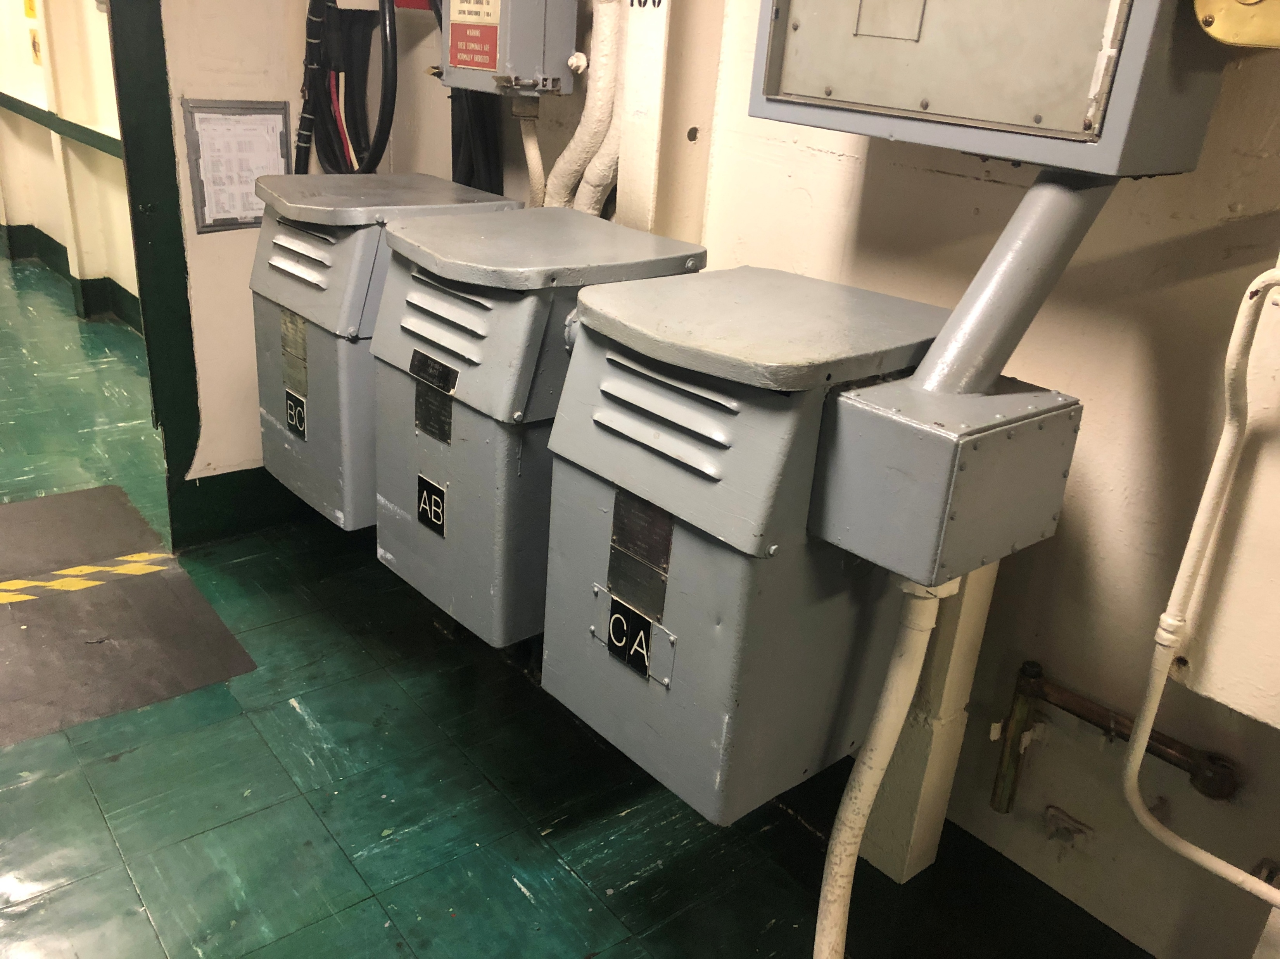
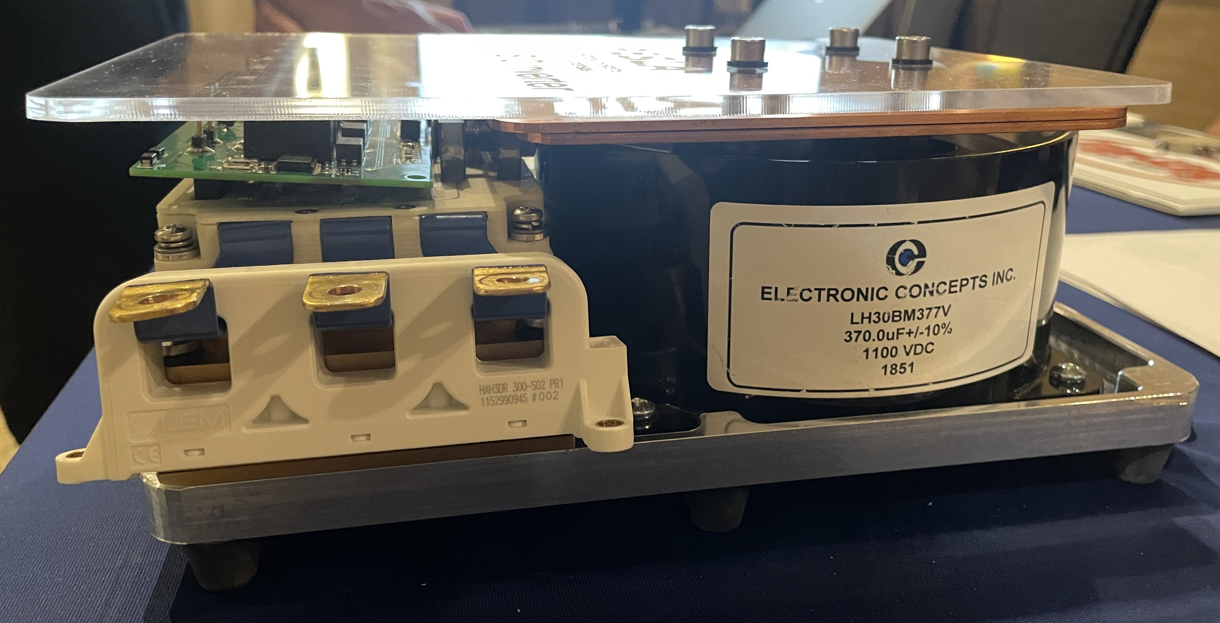
Introduction
Power conversion equipment have two or more power system interfaces
Each interface may allow power to …
Flow in exclusively
Flow out exclusively
Flow in either direction
Power balance
Power flowing in = Power flowing out + Internal losses + Power flowing into internal energy storage – Power flowing out of internal energy storage
Types
Transformers
Power electronic converters
Motor Generator Sets

Slide 4
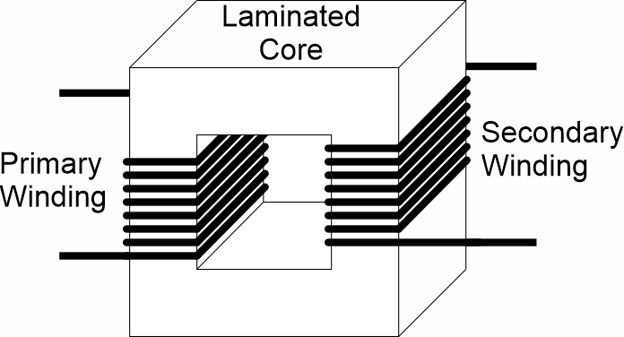
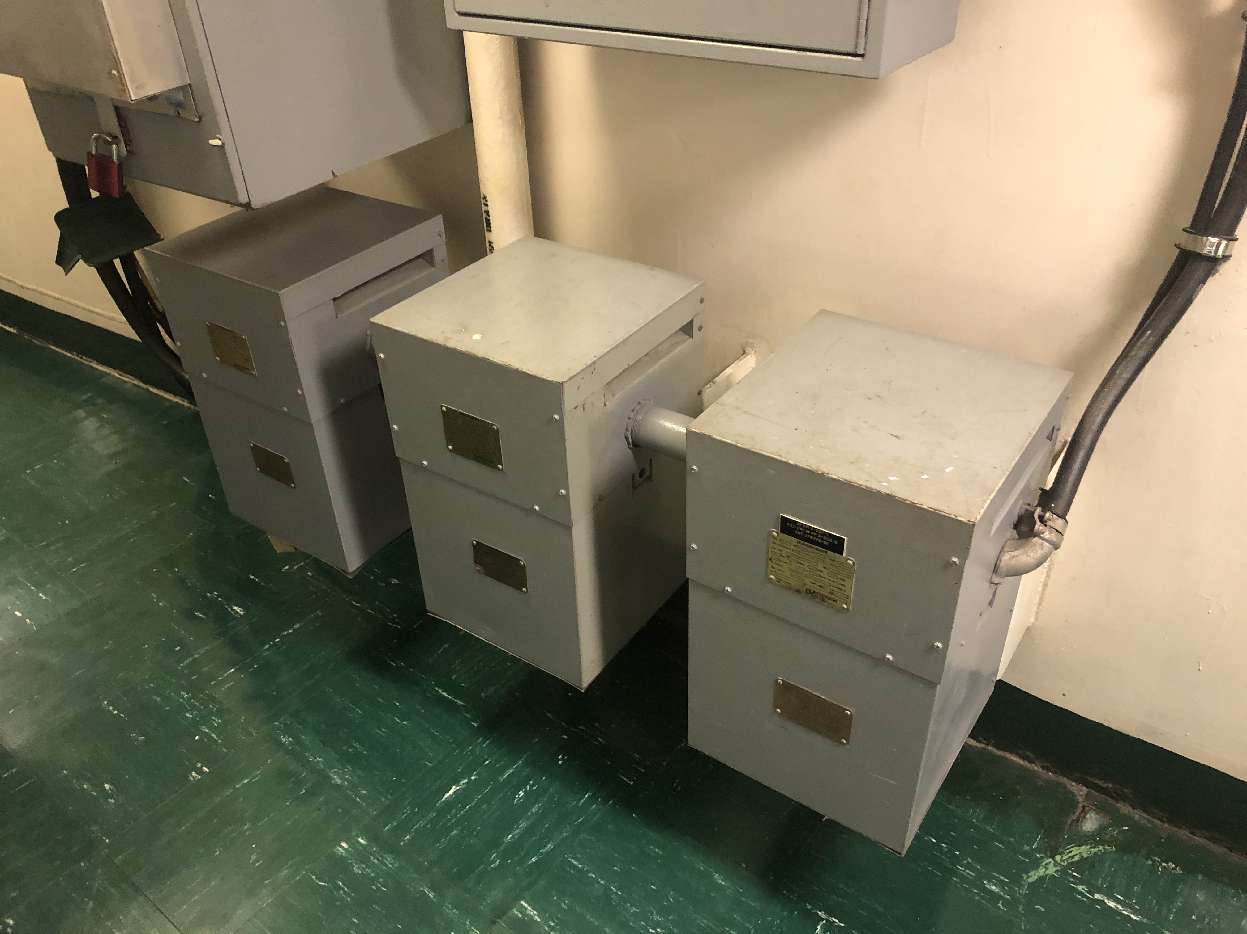
Transformers
Simple form of power conversion for a.c. systems.
Input and output voltages may be different.
Provides isolation between the primary and secondary winding.
Ground faults on one winding do not result in ground fault on the other winding.
Limits common-mode currents between primary and secondary windings.
Three phase transformers often created by interconnecting three single phase transformers.
System Integration issues
Voltage regulation – Secondary voltage drops as load increases
Can result in excessive voltage drop at loads.
Fault current – Secondary fault current can be very large.
May exceed interrupting capability of secondary circuit breakers.

Slide 5
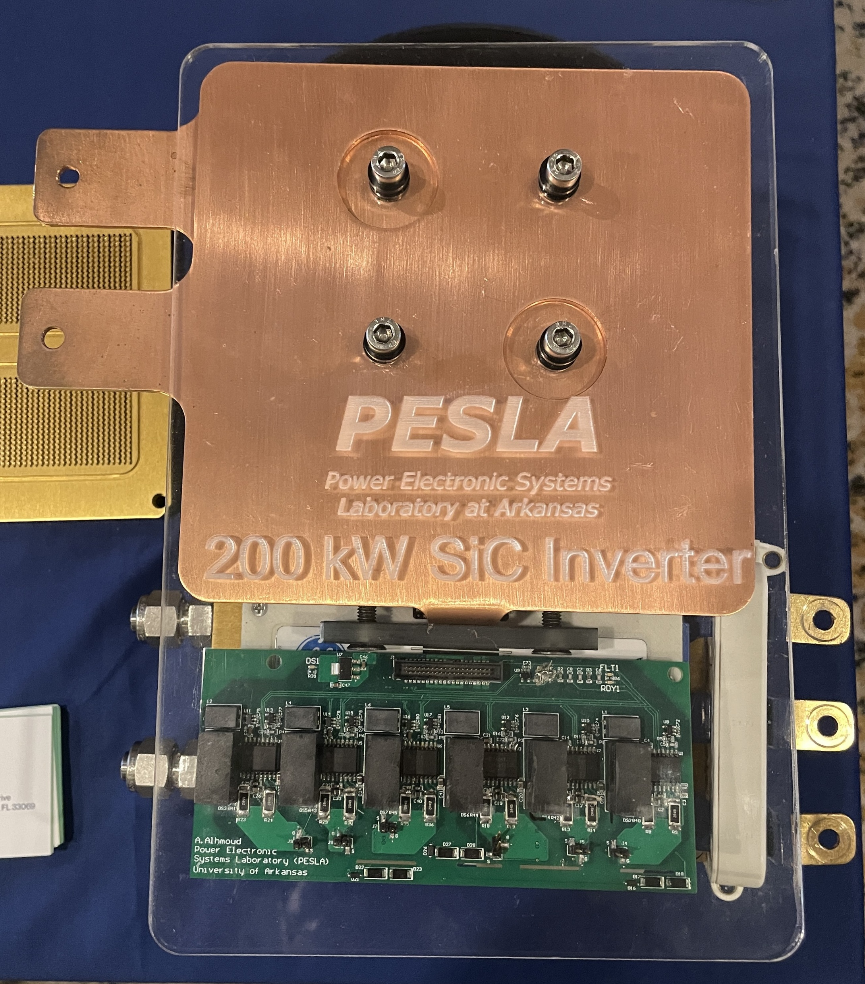
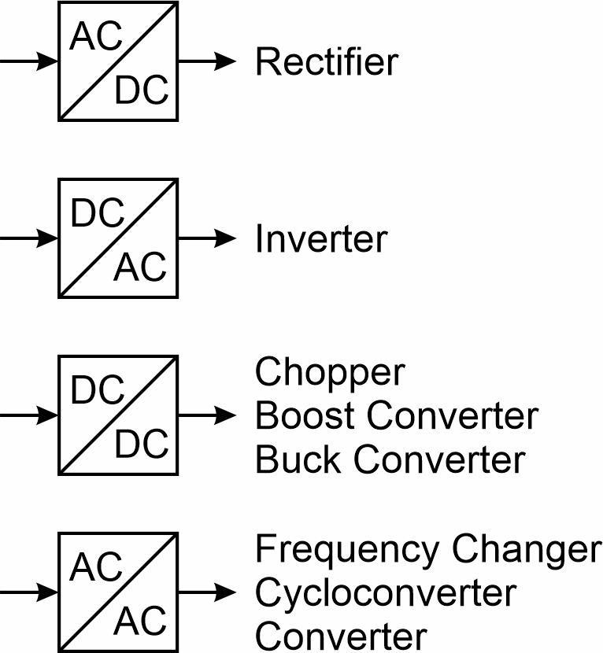
Power Electronic Converters
Rectifier
Converts a.c. to d.c.
Inverter
Converts d.c. to a.c.
Chopper, Boost Converter, Buck Converter
Converts d.c. to d.c
Frequency Changer, Cycloconverter, converter
Converts a.c. to a.c.

Slide 6
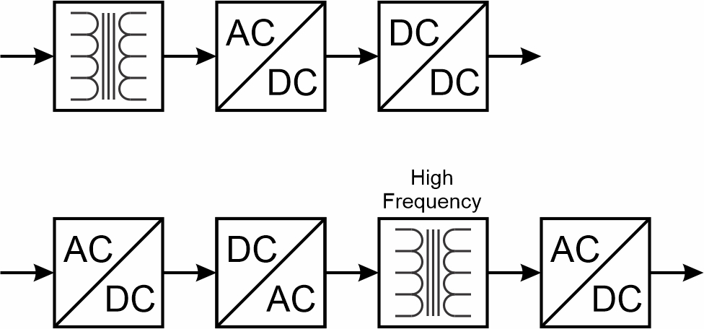
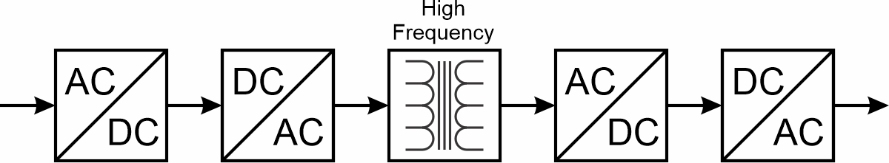
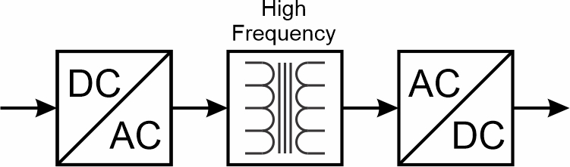
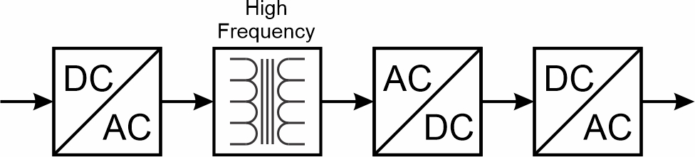
Multi-Stage Power Electronic Converter Topologies
Usually used to provide isolation between the input and power terminals
Limits extent of ground faults.
May limit common mode currents.
High Frequency Transformers decrease space and weight; and are usually more efficient than 60 Hz transformers
But usually require additional power electronics that reduce efficiency and require space and weight.

Slide 7
Power Electronic Converter Integration
Efficiency
Part load efficiency should be accounted for in system calculations.
Cooling.
Liquid cooling may require additional systems.
Frequency content of input current waveforms.
Common mode voltages and currents.
Limited inrush current capability at output.
May require soft starting of loads or use of variable speed drives.
Limited fault current capability at the output.
May require special fault protection strategy.

Slide 8
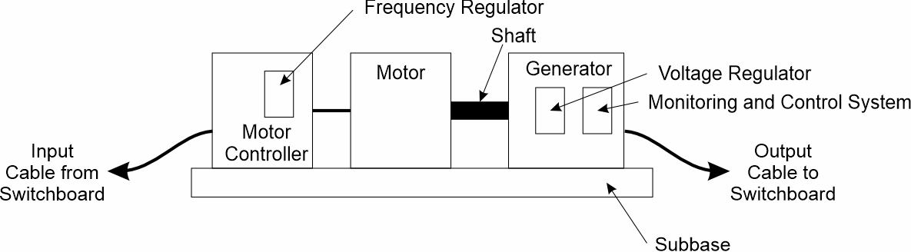
Motor Generator
Once common, now mostly replaced by power electronic converters
60 Hz to 400 Hz Frequency Changer.
Components
Motor Controller with Frequency Regulator
Motor
Generator
Voltage Regulator
Monitoring and control system
Subbase

Slide 9
Losses and Efficiency
No load losses.
Magnetize electromagnetic cores.
Cooling components (such as fans).
Control equipment.
Losses associated with output power.
Resistive losses of components.
Voltage drops across semiconductors.
Efficiency is equal to the output power divided by input power.
Efficiency is usually 0 at zero load due to no load losses.
The efficiency vs output curve is very nonlinear at low power levels.
Efficiency is usually only provided in datasheets at several power levels (typically for output power levels above 50% of rated power).
Estimating efficiency below 50% of rated power usually requires extrapolation and is prone to error.

Slide 10


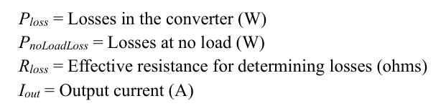
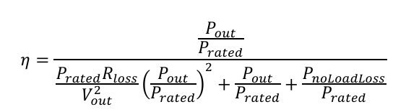

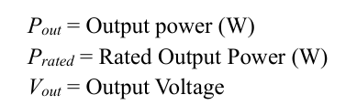

D.C. output converter efficiency extrapolation
If the data sheet does not provide
but does provide the efficiency at several output power, then the pseudo-inverse may be used to develop estimates for:

Slide 11
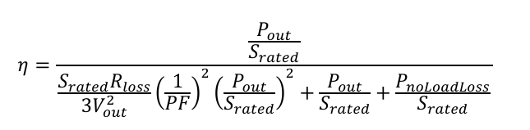
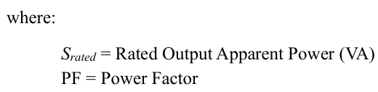

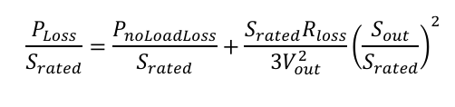

A.C. output converter efficiency extrapolation
If efficiency is provided at several points,
pseudo-inverse can be used to determine

